Slide 1




Microsoft identity platform
Doğan Erişen
Software Engineer
Developer community call
Deep dive on using MSAL.js to integrate Angular single-page applications with Azure AD
Salman Salem
Software Engineer
Kalyan Krishna
Product Manager
August 18, 2022 | 9:00AM PST
@kalyankrishna1

Slide 2


Introduction
First things first
Please note: We are recording this call so those unable to attend can benefit from the recording.
This call is designed for developers who implement or are interested in implementing Microsoft identity platform solutions.
What kind of topics will we discuss?
We will address development related topics submitted to us by the community for discussion.
We build a pipeline of topics for the next few weeks, please submit your feedback and topic suggestions - https://aka.ms/IDDevCommunityCallSurvey
View recordings on the Microsoft 365 Developer YouTube channel - https://aka.ms/M365PnP/videos
Follow us on Twitter @Microsoft365Dev and @azuread
This is NOT a support channel. Please use Stack Overflow to ask your immediate support related questions.
When is the next session?
Community Calls: Monthly – 3rd Thursday of every month

Slide 3
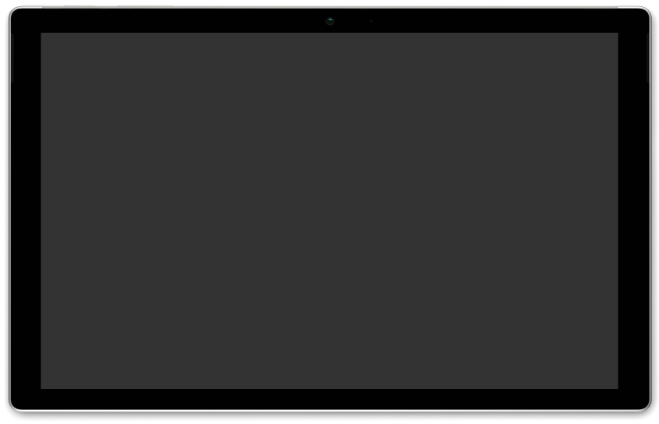


Deep dive on using MSAL.js to integrate Angular single-page applications with Azure Active Directory
– Doğan Erişen (Microsoft)
– Salman Salem (Microsoft)
– Kalyan Krishna (Microsoft)
AGENDA
Microsoft Identity dev community call 18th of August
Download recurrent invite from https://aka.ms/IDDevCommunityCalendar
Notes:
Dan’s slide

Slide 4
Agenda
Overview of MSAL.js and MSAL Angular v2
Using MSAL Angular v2 in an Angular SPA
Enabling Single Sign-on
Acquiring a token for Microsoft Graph
Continuous Access Evaluation (CAE) Events
Deployment to Azure Static Web Apps
Next steps and references

Slide 5
Microsoft Authentication Library for JavaScript

Slide 6
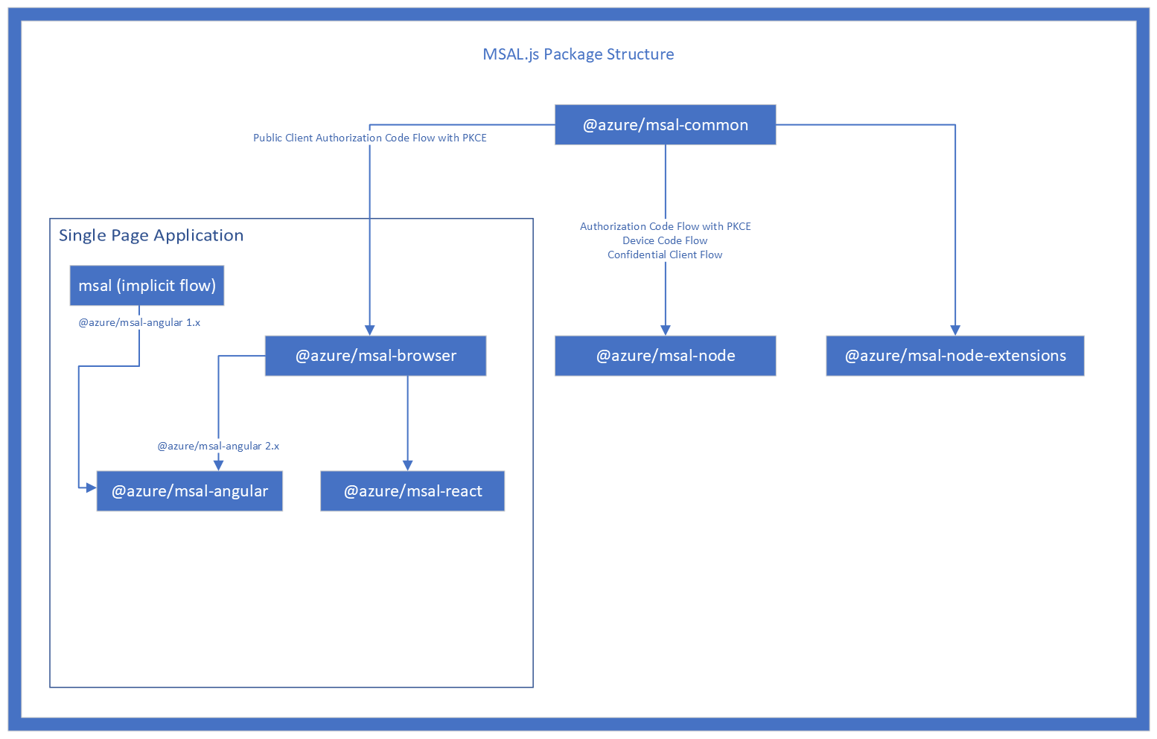
Client-side apps (public client)
Server-side apps (confidential client)
Authorization Code Grant with PKCE
Client Credentials Grant
Device Code Grant
On-behalf-of Grant
OpenID-compliant

Slide 7
MSAL Angular v2
OAuth 2.0 Authorization Code Grant with Proof Key for Code Exchange (PKCE)
Supports Angular v9 and later
Limited support for server-side rendering (Angular Universal SSR)
Same public API with msal-browser
Adds components, services and observables on top

Slide 8
Use MSAL Angular in your applications

Slide 9
Previous session on React
Using MSAL.js to integrate React Single-page applications with Azure Active Directory – July 2022

Slide 10
Use MSAL Angular in your applications
Step 1: Register your app on Azure AD (portal.azure.com)
Step 2: Download a code sample or two (aka.ms/aadcodesamples)
Step 3: Start coding!
Today’s demo github.com/derisen/msal-angular-demo
Full tutorial https://aka.ms/msalangulartutorial
Notes:
Aka.ms/link AND the full actual link

Slide 11
Prerequisites
Node.js v14+
An Azure Subscription
A GitHub account
Today’s demo github.com/derisen/msal-angular-demo
Full tutorial https://aka.ms/msalangulartutorial

Slide 12
Configuring MSAL
Option | Description | Format | Default Value
clientId | App ID of your application. Can be found in your portal registration. | UUID/GUID | None. This parameter is required in order for MSAL to perform any actions.
authority | URI of the tenant to authenticate and authorize with. Usually takes the form of https://{uri}/{tenantid} | String in URI format with tenant - https://{uri}/{tenantid} | https://login.microsoftonline.com/common
redirectUri | URI where the authorization code response is sent back to. Whatever location is specified here must have the MSAL library available to handle the response. | String in absolute or relative URI format | Login request page (window.location.href of page which made auth request)
postLogoutRedirectUri | URI that is redirected to after a logout() call is made. | String in absolute or relative URI format. Pass null to disable post logout redirect. | Login request page (window.location.href of page which made auth request)
navigateToLoginRequestUrl | If true, will navigate back to the original request location before processing the authorization code response. If the redirectUri is the same as the original request location, this flag should be set to false. | boolean | true
clientCapabilities | Array of capabilities to be added to all network requests as part of the xms_cc claims request | Array of strings | []

Slide 13
MSAL Events
Event Type | Description | Interaction Type | Payload | Error
LOGIN_SUCCESS | Successfully logged in | Popup or Redirect | AuthenticationResult
LOGIN_FAILURE | Error when logging in | Popup or Redirect |  | AuthError or Error
ACQUIRE_TOKEN_SUCCESS | Successfully acquired token from cache or network | Popup or Redirect or Silent | AuthenticationResult
ACQUIRE_TOKEN_FAILURE | Error when acquiring token | Popup or Redirect or Silent |  | AuthError or Error
LOGOUT_SUCCESS | Logout success | Redirect or Popup | EndSessionRequest or EndSessionPopupRequest
LOGOUT_FAILURE | Logout failed | Redirect or Popup |  | AuthError or Error
ACCOUNT_ADDED | Account logged-in in a different tab or window | N/A | AccountInfo | N/A
ACCOUNT_REMOVED | Account logged-out in a different tab or window | N/A | AccountInfo | N/A

Slide 14
Enabling Single sign-on

Slide 15
Single sign-on between multiple apps
SSO between different apps
If the user has an active session with Azure AD and tries to sign-in to an app using MSAL, they will automatically sign-in without entering their credentials again.
If the user has multiple active sessions with Azure AD, then the user is prompted to pick an account to sign in with
To bypass account selection screen, use a loginHint:
Session Id (sid)
login_hint (e.g. upn or preferred_username)
MSAL account object
ssoSilent method allows sign-in the user and obtain tokens without an interaction
If third-party cookies are blocked (e.g. Safari), ssoSilent will fail with:
InteractionRequiredAuthError: login_required: AADSTS50058: A silent sign-in request was sent but no user is signed in. The cookies used to represent the user's session were not sent in the request to Azure AD

Slide 16
Questions?

Slide 17
ID Token

Slide 18
Learn about and use claims provided in tokens
"aud": "66048303-7c4a-449f-b96d-9961bca5a8ce",
"iss": "https://login.microsoftonline.com/14c2f153-90a7-4689-9db7-9543bf084dad/v2.0",
"iat": 1639604770,
"nbf": 1639604770,
"exp": 1639608670,
"groups": [
"8303695c-1032-459c-8f05-d1fe424d2c3e",
"699f88b7-4e3d-458f-bef6-85e2661317a5", "a66f7d30-377a-46fa-8737-da59485e7cc5"
],
"name": "Admin user",
"oid": "5b6e08a5-7789-4ae0-a4cb-3d73b4097752",
"preferred_username": "administrator@kko365.onmicrosoft.com",
"roles": [
"Contributers",
"Writers"
],
"sub": "LiGWkvdwHuzmrCAw2feLvKoA70aq0F6er1FFsBpLEGU",
"tid": "14c2f153-90a7-4689-9db7-9543bf084dad",
"uti": "o5-ARrjdWk-aWWIjJhY2AA",
"ver": "2.0",
"wids": [
"62e90394-69f5-4237-9190-012177145e10",
"b79fbf4d-3ef9-4689-8143-76b194e85509"
This token was issued to your app Id
This token was issued in this tenant
The user belongs to these security groups
The only immutable identifier of a user/guest account in a tenant
This user belongs to these App roles
The tenant where this operation took place
The Azure AD roles assigned to this user
aka.ms/id-tokens
Notes:
Learn about the various claims available in the token and use their values to explicitly verify the user is who they claim and are allowed to operate on the application

Slide 19
Questions?

Slide 20
Caching
MSAL Browser (and MSAL Angular) caches authentication artifacts in either:
Session storage (default)
Local storage
Memory storage
local storage and session storage are considered secure if applications do not have XSS (or similar) vulnerabilities (OWASP XSS Prevention Cheat Sheet)
Furthermore:
Short-lived tokens (1 hr for access tokens, 24 hr for refresh and id tokens)
Proof of Possession (currently only for access tokens, work-in-progress for refresh tokens)
Continuous Access Evaluation (CAE) events

Slide 21
Authentication artifacts MSAL obtains from AAD
To faciliate a authN and authZ while maintaining a good UX, MSAL caches various artifacts:
Persistent auth artifacts
access tokens
id tokens
refresh tokens
accounts
Temporary auth artifacts
request metadata e.g. state, nonce, authority,
errors
interaction status
Telemetry
previous failed request
performance data

Slide 22
Logging
MSAL provides the ability to log authN/authZ activity at various levels of detail
Error
Warning
Info
Verbose
Trace
You can choose to log Personally Identifiable Information (PII) or not
MSAL also provides the ability to collect telemetry for your application

Slide 23
Questions?

Slide 24
MSAL Angular Components
MSAL Service | MSAL Broadcast Service | MSAL Guard | MSAL Interceptor
A class that provides access to MSAL application instance and the APIs/methods it epxoses. | A class that emits MSAL events, allowing you to take action when certain events occur. MsalBroadcastService exposes 2 observables using RxJs: msalSubject$ for accessing events, and inProgress$ for accessing current interaction status. | A class you can use to protect routes and require authentication before accessing the protected route. MSAL Guard should not be relied upon for security. Attackers can potentially get around client-side guards, and you should ensure that the server does not return any data the user should not access. | A class that automatically acquires tokens for outgoing requests that use the Angular http client to known protected resources. MSAL Interceptor is designed to acquire tokens silently. In the event that a silent request fails, it will fall back to acquiring tokens interactively.

Slide 25
Get an access token for Microsoft Graph
Today’s demo github.com/derisen/msal-angular-demo
Full tutorial https://aka.ms/msalangulartutorial

Slide 26
Questions?

Slide 27
Continuous Access Evaluation (CAE)

Slide 28
Continuous Access Evaluation (CAE)
CAE introduces real time enforcement of account lifecycle events and policies:
Account revocation
Account disablement/deletion
Password change
User Location change
User risk increase
Tenant admins are being encouraged to enable CAE in their tenants
Developers need to explicitly add support for CAE in their apps.
Learn about claims challenge and client capabilities - aka.ms/ClaimsChallenge

Slide 29
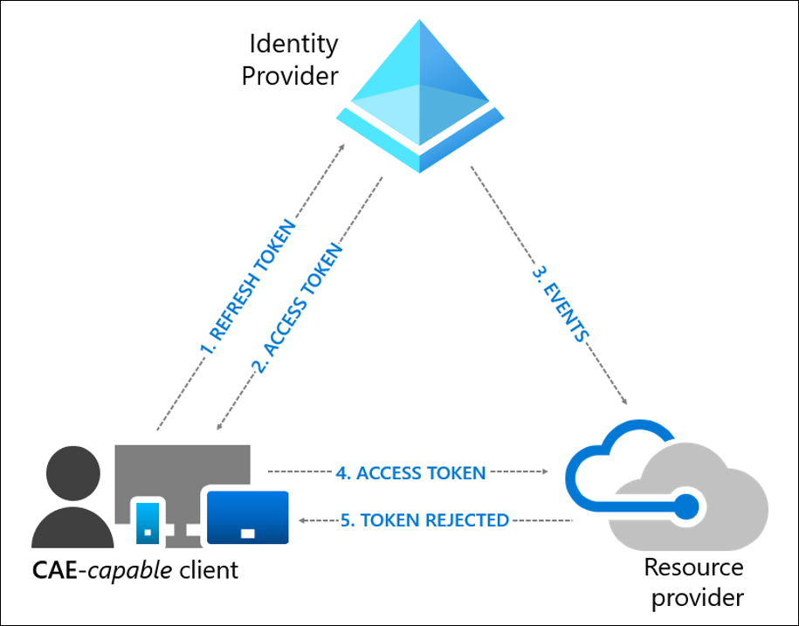
Handling CAE Challenges
Continuous Access Evaluation (CAE) is an Azure AD feature that allows access tokens to be revoked based on critical events and policy evaluation rather than relying on token expiry based on lifetime.
HTTP 401;
Unauthorized WWW-Authenticate=Bearer authorization_uri="https://login.windows.net/common/oauth2/authorize",
error="insufficient_claims",
claims="eyJhY2Nlc3NfdG9rZW4iOnsibmJmIjp7ImVzc2VudGlhbCI6dHJ1ZSwgInZhbHVlIjoiMTYwNDEwNjY1MSJ9fX0=”

Slide 30
Steps to handle CAE challenges
Step 1: Configure your MSAL app to declare that it’s capable of handling claim challenges
Step 2: Grab the www-authenticate header from the 401 response
Step 3: Process the header
Step 4: Pass the claims challenge to MSAL as a request parameter
CAE Code example - > https://github.com/Azure-Samples/ms-identity-javascript-angular-tutorial/blob/main/2-Authorization-I/1-call-graph

Slide 31
Questions?

Slide 32
Learn More
MSAL.js on GitHub
MSAL Browser docs
MSAL Angular docs
MSAL Angular samples:
Testing samples
Chapter wise tutorials – aka.ms/msalangulartutorial
Microsoft identity platform:
OAuth 2.0 Authorization Code Grant
Single Sign-on with MSAL.js
Continuous Access Evaluation
Code samples – aka.ms/aadcodesamples
OWASP XSS Prevention Cheat Sheet

Slide 33
Thank you
Recording will be available soon on the
Microsoft 365 Community (PnP) YouTube channel
https://aka.ms/M365PnP/videos
(subscribe today)
Follow us on Twitter
@Microsoft365Dev and @azuread
Survey - https://aka.ms/IDDevCommunityCallSurvey
Next call: September 15th at 9:00am PST
https://aka.ms/IDDevCommunityCalendar

